Slide 1
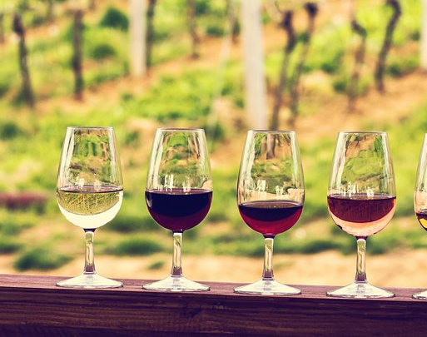
Bacchus Winery Case Study CSD 310
Alpha Group
Bordwell, Hadi, Morales, Songcuan
This Photo by Unknown author is licensed under CC BY.

Slide 2

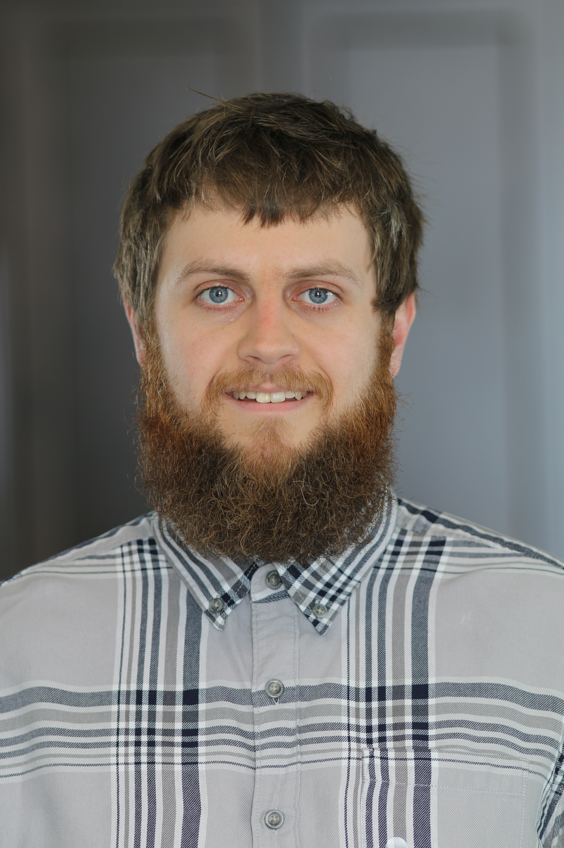
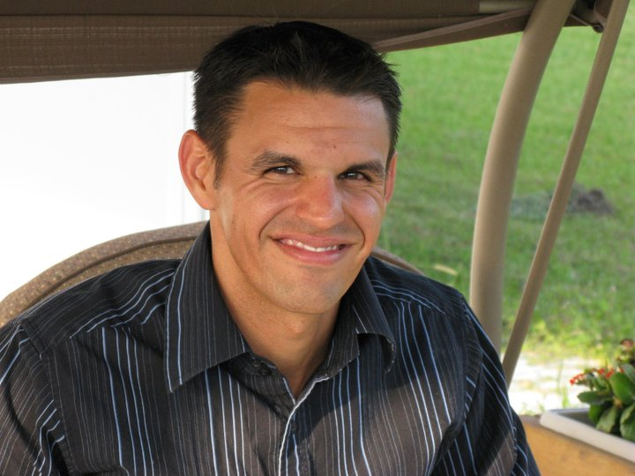
Group Introduction
Hello, my name's Benjamin Bordwell. I live in Ames, Iowa with my Wife. Currently, I work at a distribution center that supplies a large grocery store chain. I've lived many places, including Alabama, Germany, Kansas, and Iowa. There is love engrained in me for problem solving leading to how I got into software development in the first place, and, am now pursuing a degree in it.
Hello, I'm Nelson Morales. I have the pleasure of calling Orlando, Florida, the house of "Mikey Mouse", my home. At present moment, I call Walt Disney World my place of employment, as a server in one of their many restaurants. I too have labeled a few different areas my home, from Las Vegas, Nevada, to Long Island, New York, and Orlando, Florida. I have always been thoroughly interested in software application and its design/implementation within society. That curiosity has led me to the degree that I'm seeking.

Slide 3
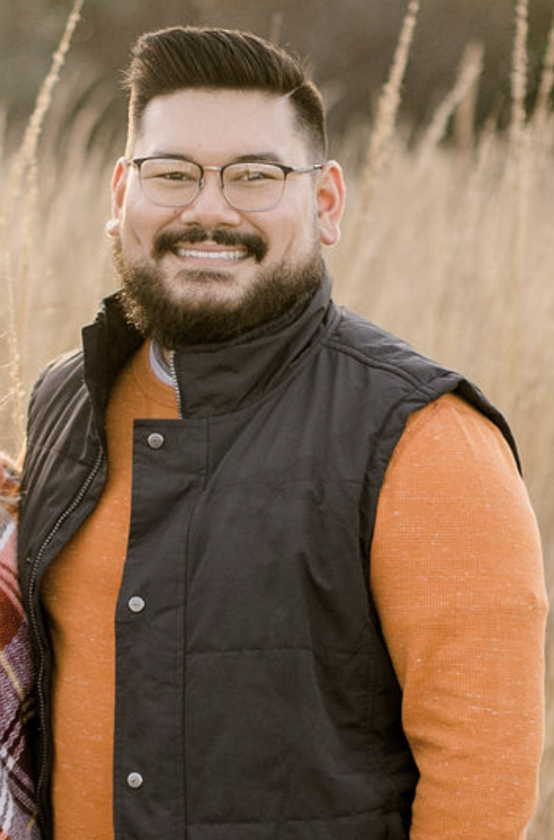
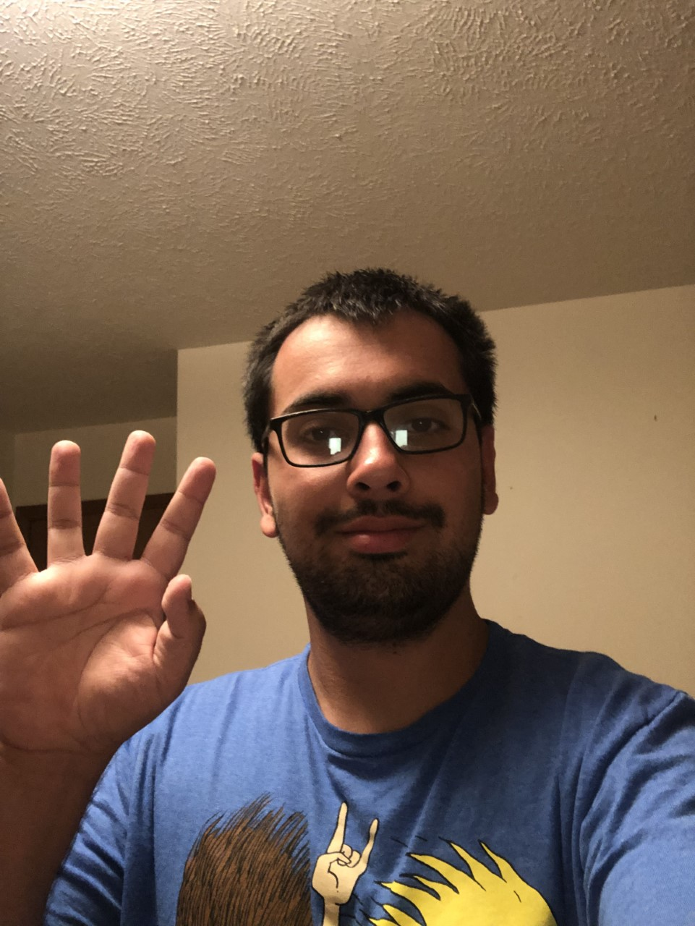
Group Introduction
Hi, I am Ryan Songcuan. I grew up an Air Force brat and moved around a lot growing up, and I'm currently calling Nebraska home. I graduated from Gonzaga University with a degree in Sport Management and Marketing in 2016 but joined this Software Development program for a career change. I'm currently engaged and will get married in June 2022.
Hello, my name is Dawood Hadi. I was born and raised in Omaha, Nebraska. I graduated from Metropolitan Community College with an associates degree in Applied science majoring in IT with a minor in programming for database and web. I am currrently in the process of majoring with a BS in Software developmen​t because of how interesting coding looked to me.

Slide 4
Case Study Description
George Bacchus owned Bacchus Winery, retired 3 years ago, and hand the family business down to son's Stan and Davis.
Upon their retainment, all existing employees were kept. Among them, important ones such as Janet Collins, department head of finances and payroll. Roz Murphy, department head, and assistant, Bob Ulrich, of marketing. Henry Doyle, production line department head, leading 20 employees. Last, but not least, Maria Constanza, department head of distribution.
Major wines produced; Melot, Cabernet, Chablis, and Chardonnay. Stan and Davis have a yearly look into the business but with supplies such as bottles/corks coming from one supplier, labels/boxes from another, and vats/tubing even coming from another there is a sense of disarray among the business.
They need reported information on if all suppliers are delivering on time, if there is any large gaps between expected and actual delivery, and monthly reports on any problem areas. They’re also needing reports on if all wines are selling as originally thought. If not, which one isn't selling? Reports are, as well, needed of the individual wine distributors. Lastly, to make sure all employees are paid correctly, reports needed to be produced of employees' hours clocked for the last 4 quarters.

Slide 5
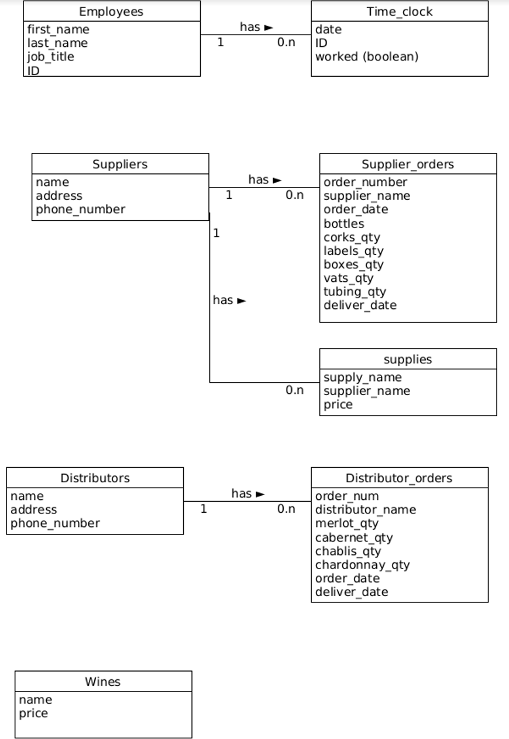
ORD (Oriented Relational Diagram):
Business Rules:
An Employee has many clock-ins
A Supplier has many Supply Orders
A Supplier has many Supplies
A Distributer has many Orders
A Winery has many Wines

Slide 6
Assumptions:
Distributors order wine by the case, not individual bottles
Each case contains 12 bottles
Each bottle uses one cork and one label
If an employee clocks in, it is assumed they worked 8 hours that day
On-time delivery of each order requires delivery within 2 weeks
Orders are considered a late delivery if greater than 2 weeks from ship date
Use of 2 vats and 8 tubing per month when ordering supplies

Slide 7
Report 1 Description:
The first report generated was to determine if the supplies from all suppliers were on time or late, and what the average late time was as a total result. Here the Bacchus' can decide on possibly changing suppliers or finding out how they lessen lag time.

Slide 8
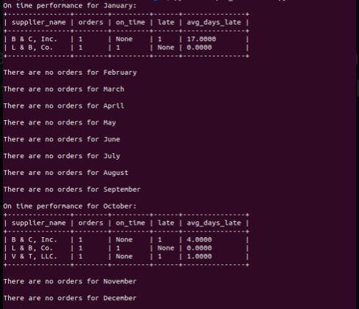
Report 1:

Slide 9
There were orders for January and October, so the Bacchus brothers have the opportunity to looking into ordering from suppliers during other months but from the reports show the B & C have been late by either 4 or 17 days late. This can ultimately hurt business and is cause for alarm.
Report 1 Result:

Slide 10
Report 2 Description:
The second report generated was displayed to account for total hours worked among the employees, including the Department Heads, marketing assistant, as well as the 20 employees of the Production Line, denoted by characters A through S. Through our reports The Bacchus brothers can tell where they can make certain decisions in a particular department to maximize time within production hours.

Slide 11
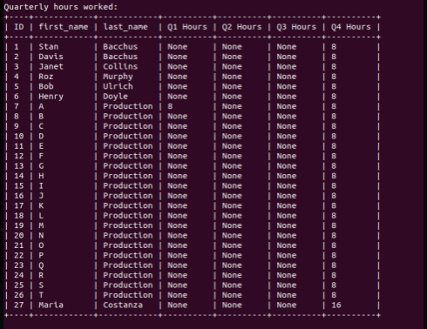
Report 2:

Slide 12
Report 2 Result:
There has been minimal work over the last 3 quarters, and it shows Maria has been putting in extra time leading to some possible recognition to keep up the hard work.

Slide 13
Report 3 Description:
Within this report we generated the total amount of each wine sold per distributor and then we can analyze which aren't selling as well among Bacchus Winery's Distributors and possibly can up the par on a better selling wine there or delete that inventory if necessary.

Slide 14
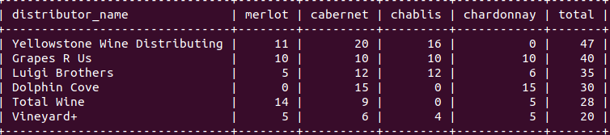
Report 3:

Slide 15
Report 3 Result:
Vineyard + is a low selling distributor and Bacchus may need to search for a different distributor. Dolphin Cove may need some talking to about increasing inventory of Cabernet and Chardonnay since sales seem to strong with those wines . Bacchus may want to talk with their own marketing team about materials that would increase Chardonnay sales within Yellowstone Wine Distributing since all other wines are selling well for them and Bacchus could increase its own personal sales with the introductory of the other wine..

